Slide 1
C Programming Language
Programming fundamentals

Slide 2
Syntax:
#include <stdio.h> int main() { printf("Hello World!"); return 0; }

Slide 3
Statement
A computer program is a list of "instructions" to be "executed" by a computer.
In a programming language, these programming instructions are called statements.
From the example below, we have three statements:
printf("Hello World!");
printf("Have a good day!");
return 0;

Slide 4
Comments
Comments can be used to explain code, and to make it more readable. It can also be used to prevent execution when testing alternative code.
Comments can be singled-lined (//)or multi-lined (/* */).
// Print hello world printf("Hello World!");

Slide 5
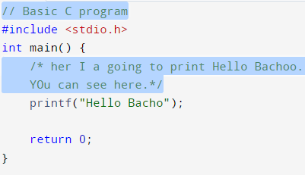
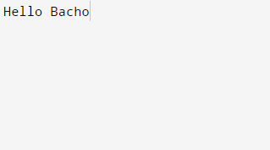
Execution

Slide 6
Variables
Variables are containers for storing data values, like numbers and characters.
int - stores integers (whole numbers), without decimals, such as 123 or -123
float - stores floating point numbers, with decimals, such as 19.99 or -19.99
char - stores single characters, such as 'a' or 'B'. Characters are surrounded by single quotes

Slide 7
Declaring (Creating) Variables
type variableName = value;
int myNum = 15;
float num=75.78;
char alph=‘a’;

Slide 8
Format Specifiers
Utogether with the printf() function to tell the compiler what type of data the variable is storing.
It is basically a placeholder for the variable value.
int myNum = 15; float myFloatNum = 5.99; char myLetter = 'D';
printf("%d\n", myNum); printf("%f\n", myFloatNum); printf("%c\n", myLetter);
%d or %i for int, %f for float, %c for char, %lf for double, %s for string, %lu for printing result

Slide 9
Decimal Precision
float myFloatNum = 3.5;
printf("%f\n", myFloatNum); // Default will show 6 digits after the decimal point
printf("%.1f\n", myFloatNum); // Only show 1 digit
printf("%.2f\n", myFloatNum); // Only show 2 digits
printf("%.4f", myFloatNum); // Only show 4 digits

Slide 10
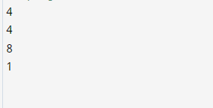
Memory Size
int myInt;
float myFloat;
double myDouble;
char myChar;
printf("%lu\n", sizeof(myInt));
printf("%lu\n", sizeof(myFloat));
printf("%lu\n", sizeof(myDouble));
printf("%lu\n", sizeof(myChar));

Slide 11
Type Conversion
Convert the value of one data type to another type.
There are two types of conversion in C:
Implicit Conversion (automatically)
Explicit Conversion (manually)

Slide 12
Implicit
Implicit conversion is done automatically by the compiler when you assign a value of one type to another.
For example, if you assign an int value to a float type:
This can be risky, as you might lose control over specific values in certain situations.

Slide 13
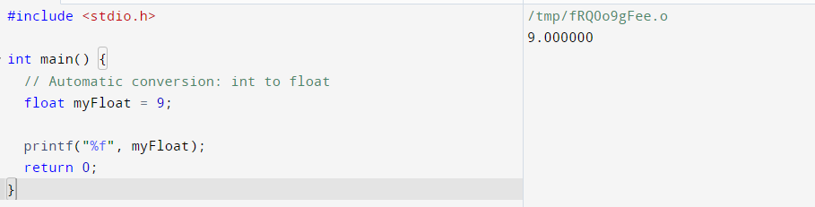
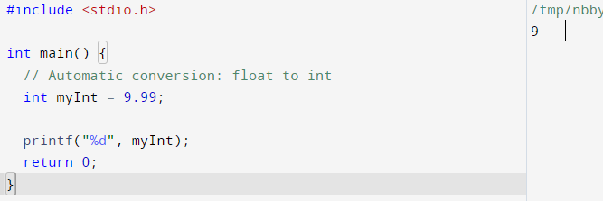
Contd.

Slide 14
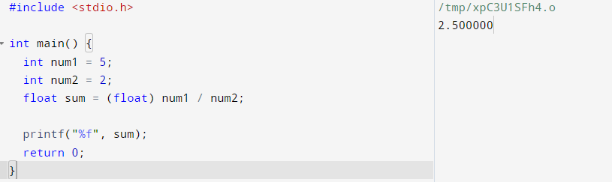
Explicit
Explicit conversion is done manually by placing the type in parentheses () in front of the value.

